Slide 1
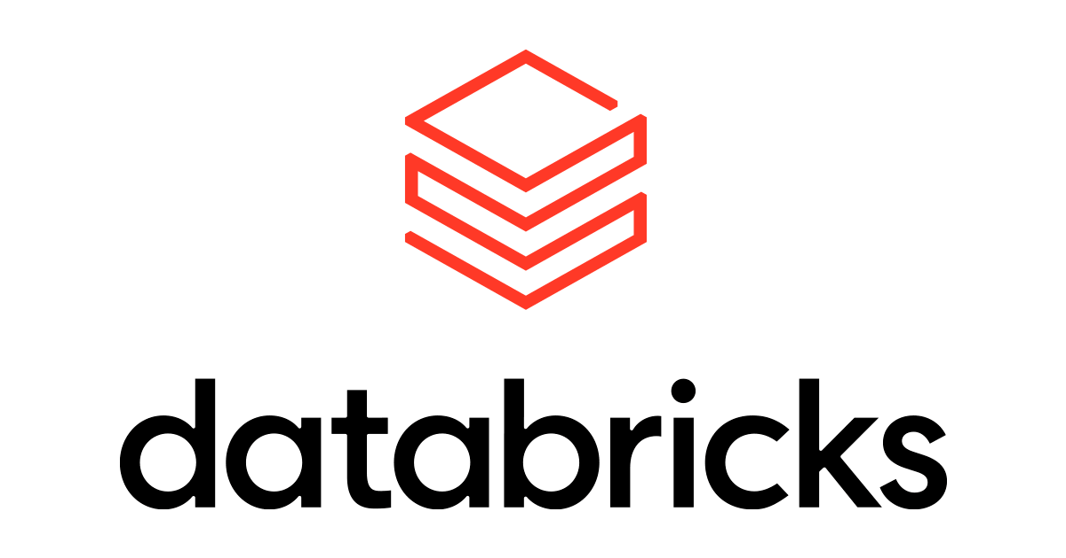
Implement LLMOps in Azure Databricks
(Dr Sachin Saxena)

Slide 2
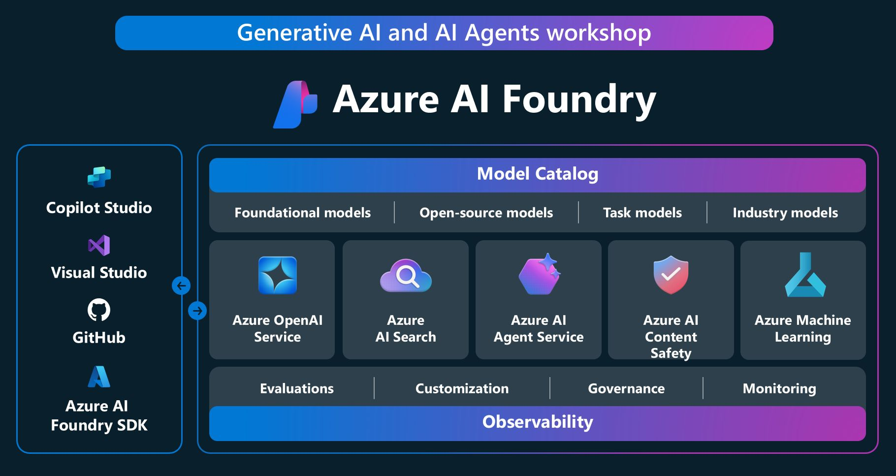

Slide 3
Azure Foundry
1) 𝗚𝗲𝗻𝗲𝗿𝗮𝘁𝗶𝘃𝗲 𝗔𝗜 𝘄𝗶𝘁𝗵 𝗔𝘇𝘂𝗿𝗲 𝗙𝗼𝘂𝗻𝗱𝗿𝘆 – a structured course with mixing “Learn” and “Build” modules (Python), ideal for getting from concepts to code fast.
𝗔𝗜 𝗔𝗴𝗲𝗻𝘁𝘀 𝘄𝗶𝘁𝗵 𝗦𝗲𝗺𝗮𝗻𝘁𝗶𝗰 𝗞𝗲𝗿𝗻𝗲𝗹– a lesson track on agents, use cases, and design building blocks, with multi-language content and a friendly on-ramp for those new to GenAI.
𝗔𝗜 𝗔𝗴𝗲𝗻𝘁𝘀 𝘄𝗶𝘁𝗵 𝗦𝗲𝗺𝗮𝗻𝘁𝗶𝗰 𝗞𝗲𝗿𝗻𝗲𝗹– a lesson track on agents, use cases, and design building blocks, with multi-language content and a friendly on-ramp for those new to GenAI.

Slide 4
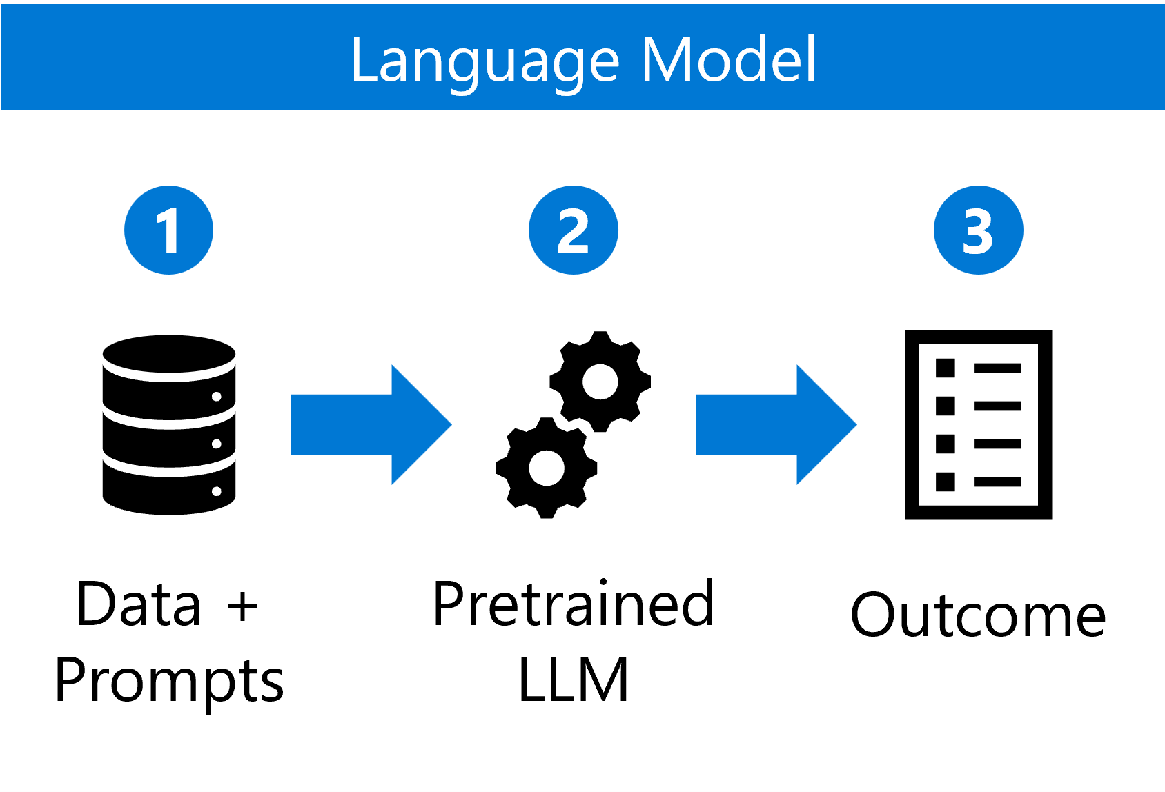
Large Language Model Operations
LLMOps, or Large Language Model Operations, is a new field focused on the deployment, management, and optimization of Large Language Models (LLMs) in real-world applications.
As the use of Generative AI and LLMs like GPT-4 grows across industries, LLMOps addresses the unique challenges of integrating these models into production environments.
Implementing LLMs in production includes model deployment, fine-tuning, monitoring, and ensuring ethical and responsible use of AI.

Slide 5
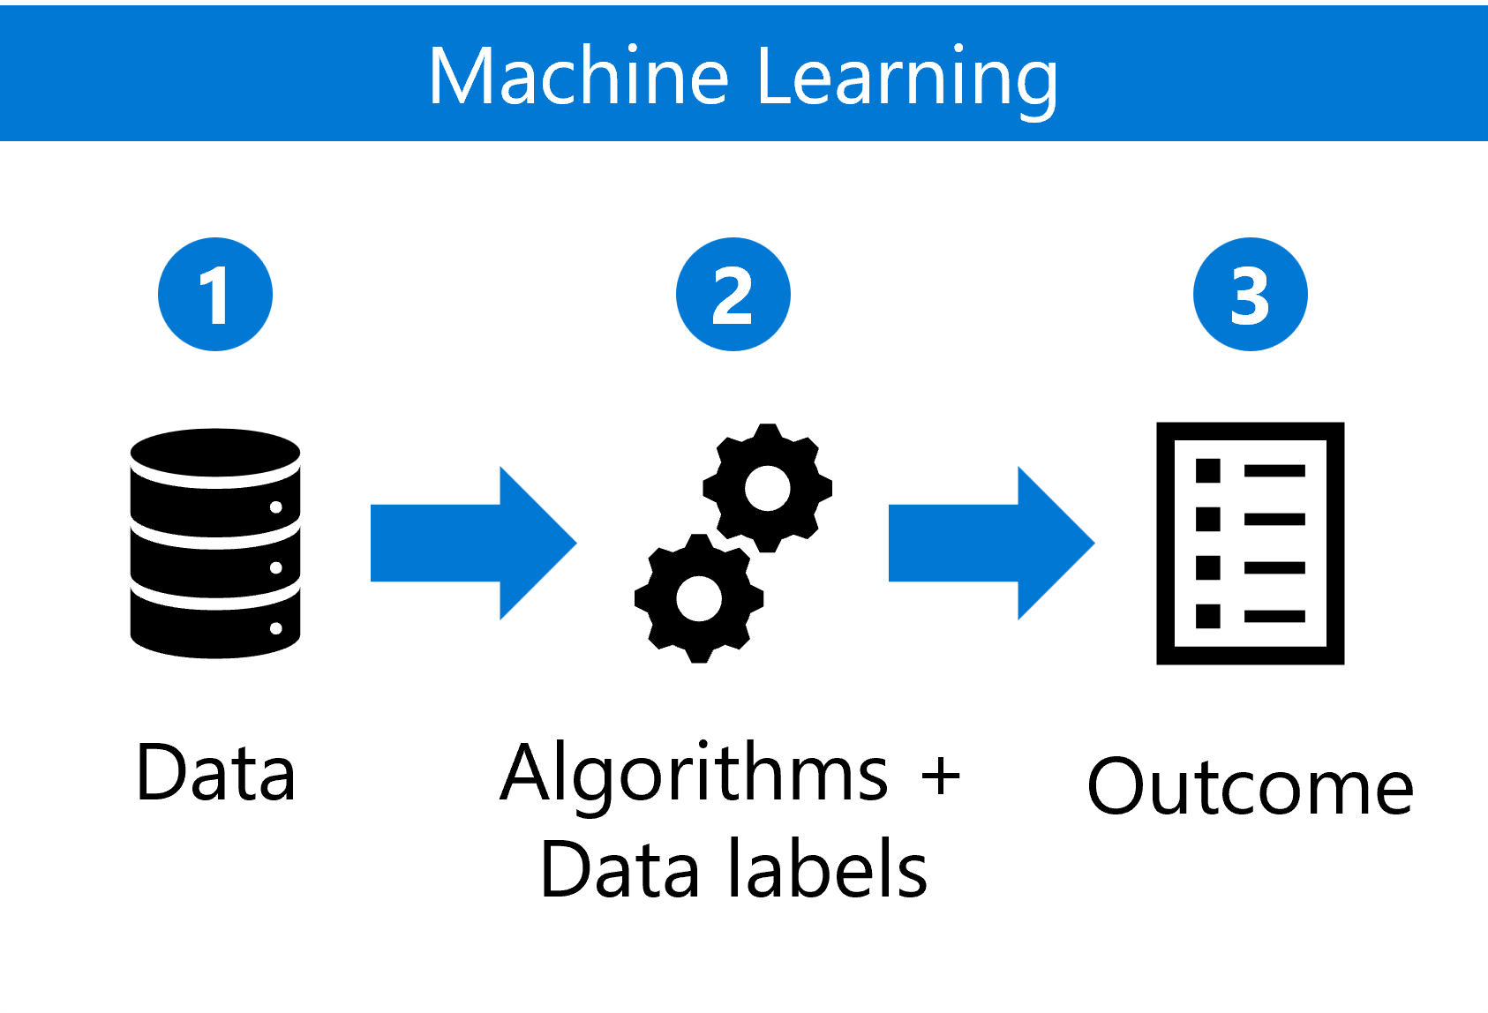
Compare MLOps to LLMOps
MLOps (Machine Learning Operations) and LLMOps (Large Language Model Operations) represent two distinct paradigms in the operationalization of machine learning models, each with its own set of challenges, tools, and workflows.
While traditional MLOps focuses on deploying and managing a wide variety of machine learning models, LLMOps is tailored specifically for Large Language Models (LLMs), which have unique requirements in terms of scale, data management, and model tuning.
Azure Databricks supports both MLOps and LLMOps, but the implementation details differ significantly. Let's explore the difference by comparing MLops to LLMOps.

Slide 6
Understand model deployments
There are four deployment strategies:
Batch: Generate and store completions on a table of text inputs or prompts. For example, to summarize financial reports and generate insights.
Streaming: Generate and store completions on micro-batches of text inputs or prompts as they're processed. For example, to personalize marketing messages.
Real-time: Generate completions asynchronously in real-time on an individual input or prompt. For example, for chatbots used in customer service.
Embedded or edge: Deploy the model on local devices or edge servers to provide low-latency responses and offline capabilities. For example, to modify the air conditioning temperature in a car using voice command.
Tools like LangChain and LlamaIndex allow for the creation of chains, which are sequences of operations that process and transform data through various stages. By using LLMs at different points within these chains, you can achieve sophisticated data processing and transformation capabilities.

Slide 7
Describe MLflow deployment capabilities
Deploying means setting up the model on infrastructure where it can run. Serving means the endpoint is ready to receive requests (like prompts) and return responses (generated text).
MLflow provides an environment for managing Large Language Models from development to production.
MLflow handles both deployment and serving through its integration with Azure Databricks' Model Serving feature. You can start by using one of the foundation models already available in Azure Databricks

Slide 8
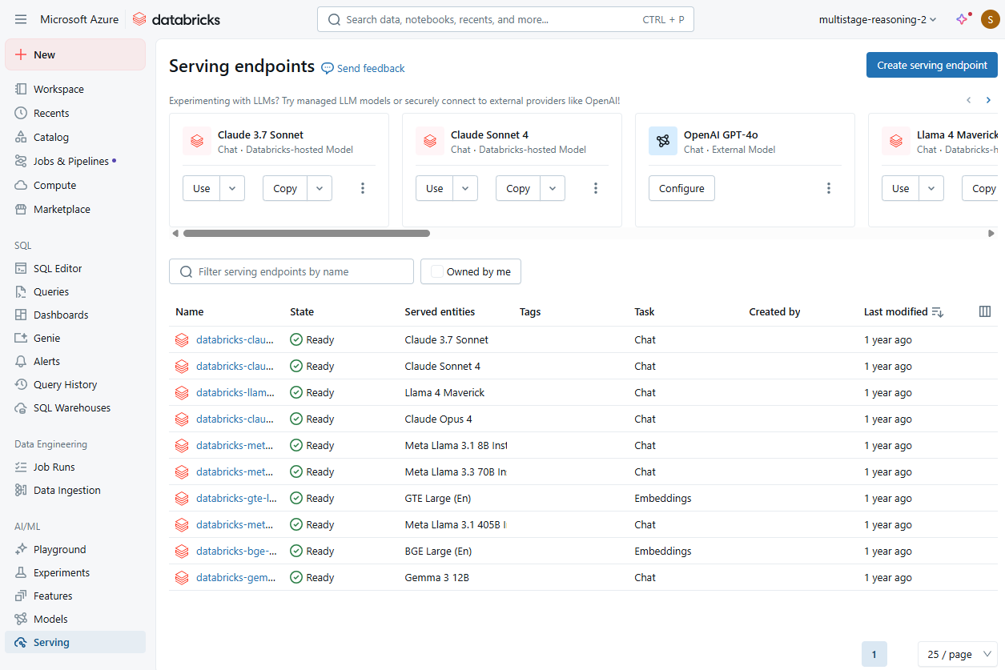

Slide 9
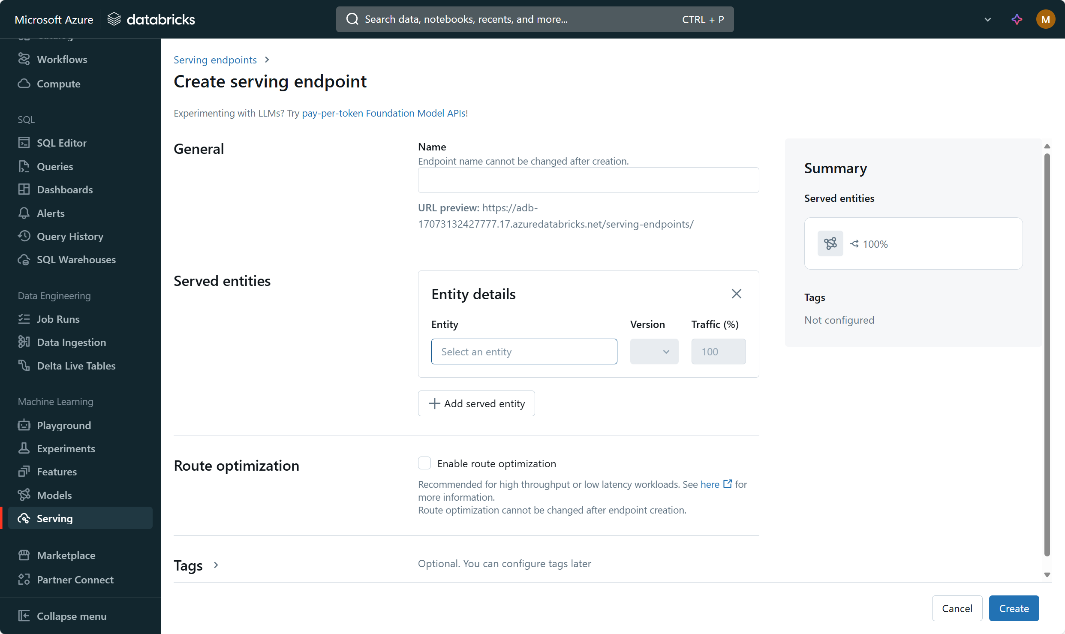

Slide 10
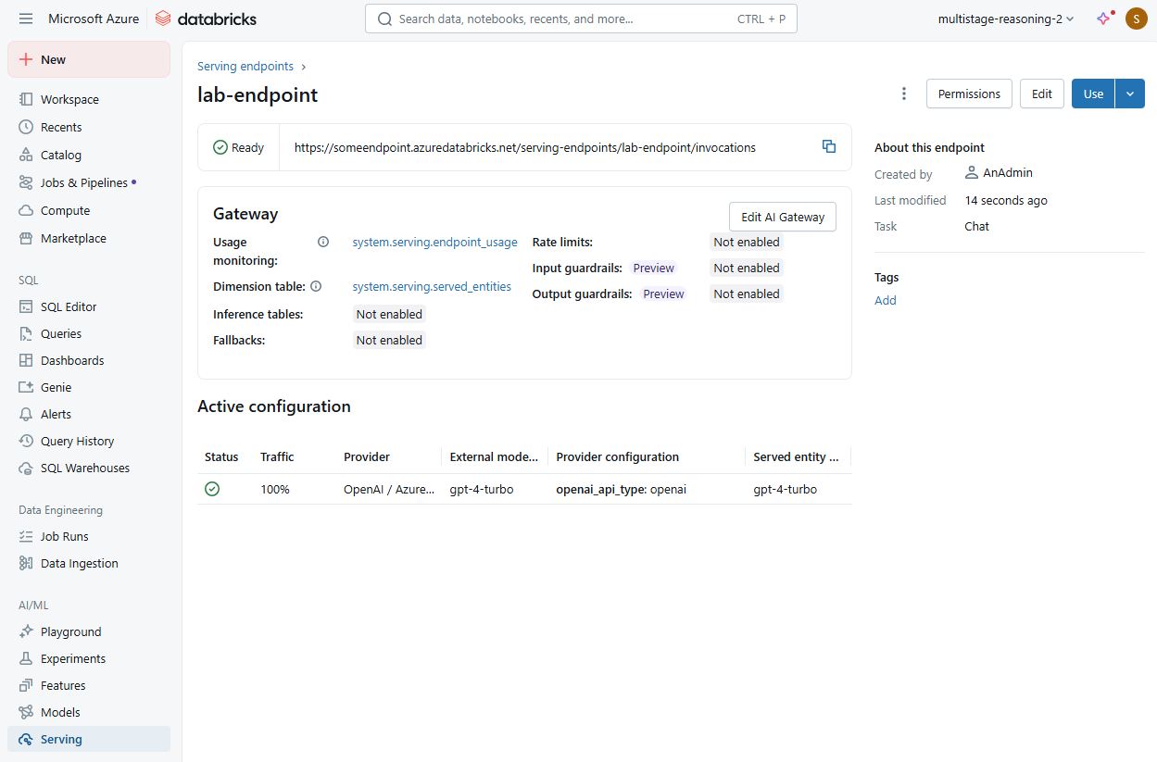

Slide 11
Resource:
Exercise - Implement LLMOps - Training | Microsoft Learn
https://learn.microsoft.com/en-us/training/modules/implement-llmops-azure-databricks/06-exercise

